Slide 1

Implementation of SEEA and Ecosystem Accounts in the Russian Federation: Prospects, Opportunities and Challenges
Joint OECD/UNECE Seminar on the Implementation of SEEA
13-14 February 2020, Geneva
Marina Klevakina, Deputy Head,
Agricultural and Environmental Statistics Department, Russian Federal State Statistics Service (Rosstat)
Georgy Fomenko, Head of Research,
Cadaster Institute, Doctor of Science in Geography, Professor

Slide 2
Relevant legislation in the Russian Federation
Federal Law of November 29, 2007 N 282-FZ (as amended on April 18, 2018)
“On Official Statistical Accounting and the System of State Statistics in the Russian Federation”
  Official statistical methodology, corresponding to international standards and principles of official statistics, which is prepared by the subjects of official statistical accounting and approved by them on agreement with Rosstat
Federal Law of January 10, 2002 N 7-FZ
(as amended on July 26, 2019)
“On Environmental Protection”
  Formalized need for economic evaluation of natural and natural-anthropogenic objects (Article 5)
Order of the Government of the Russian Federation of May 06, 2008 N 671-r
(as amended on November 29, 2018)
“On Approval of the Federal Plan of Statistical Work”
  Preparation and dissemination of official statistics on SEEA accounts indicators by federal executive bodies as official statistics stakeholders and providers
Decree of the Government of the Russian Federation dated 06.06.2017 N 1170-r
“On the Coordination Work of the Bodies of Official Statistical Accounting by Formation and Providing to International Organizations the Official Statistics on Reaching of Sustainable Development Goals in the Russian Federation”
  Russian Federal State Statistics Service (Rosstat) as an official responsible coordinator on formation and providing to international organizations the official statistics on reaching of SDGs in the Russian Federation in accordance with international standards
Order of the Deputy Chair of the Government of the Russian Federation dated November 19, 2019 N AG-P9-10033
“On Development of an Action Plan (Road Map) for the Implementation of Priority Accounts of the System of Environmental-Economic Accounting”
  Objective to develop and submit to the Government of the Russian Federation an action plan (“road map”) for the implementation of priority accounts of the system of environmental-economic accounting

Slide 3
Actions taken to include natural assets into the SNA balance sheet
Mineral and energy resources
2013
1. DEVELOPMENT OF METHODOLOGICAL APPROACHES TO THE EVALUATION OF NATURAL RESOURCES AT THE CURRENT MARKET VALUE AND CALCULATION OF THE PRODUCTIVITY OF NATURAL RESOURCES
Natural resource productivity
2018
Lands
2014
Water resources
2013
Non-cultivated biological animal and plant resources
2014
Aquatic resources
2015
Methodology for evaluation of mineral resources in physical and monetary terms and their changes for the year
(2018)
2. APPROVED STATISTICAL QUESTIONNAIRE AND APPLIED METHODS OF ASSESSING NATURAL RESOURCES AT THE CURRENT MARKET VALUE (orders of the Russian Ministry of Environment).
Methodology for evaluation of water resources in physical and monetary terms and their changes for the year
(2019)
Statistical questionnaire
No.1-RSPI “Information on the Current Market Value of Mineral Reserves” (2017)
Methodology for evaluation of uncultivated biological resources in physical and monetary terms and their changes for the year
(2018)
Methodology for evaluation of aquatic resources in physical and monetary terms and their changes for the year (pending approval)
Balance sheet as of the end of 2017 (fragment) | Billion RUB
Assets | 902 220
Non-financial assets | 411 037
Mineral and energy resources | 55 238
Non-cultivated biological animal and plant resources | 5 761

Slide 4
Methodological developments for particular accounts
compilation by Russian Federal State Statistics Service
Experimental compilation
Development of applied algorithms
Project of guidelines
Air emissions account
2019
2020
Physical water flow account
2019
2019
Environmental protection expenditure account
2018
2020
2020
Environmentally related tax revenue account
2018
2019
2020
Environmental subsidies and similar transfers account
2019
Asset accounts for timber resources
2019
2020

Slide 5
Roadmap for the implementation of SEEA accounts in Russian statistical practice
Purpose:
approving the process of the consistent development and implementation of SEEA accounts
Set of measures:
normative legal support of data production and interagency data exchange
guidelines for data production
providing of official statistics
Criteria for selection of priority accounts
Information availability – availability of official data to fill in the cells of the account, as well as the possibility of obtaining missing data
Guidelines elaboration – availability of clear and well-defined content of indicators, guidelines and algorithms for obtaining information and producing data
Implementation principles
Step-by-step implementation of SEEA accounts
Flexible and modular approach
Interagency interaction
(working groups)
Relevance – implementation of national development priorities and the need for international comparisons

Slide 6
Prospects for the implementation of SEEA accounts in the Russian Federation
Short term (2020-2024) – priority SEEA accounts
priority SEEA accounts which do not require significant groundwork, provide information for achievement of the development priorities of the Russian Federation, which are relevant for international comparisons, calculations of SDG indicators and OECD green growth indicators
Medium term
Long term
SEEA accounts which are relevant for international comparisons but require significant resources for guidelines elaboration and receiving necessary data.
Ecosystem accounts
SEEA accounts which require significant resources for guidelines elaboration and receiving the necessary data

Slide 7
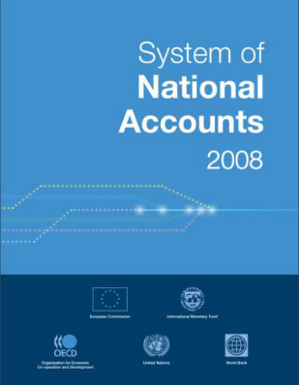
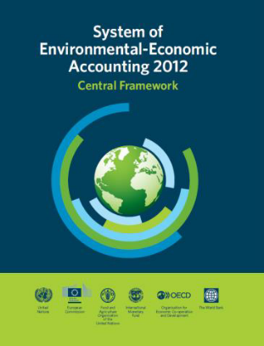
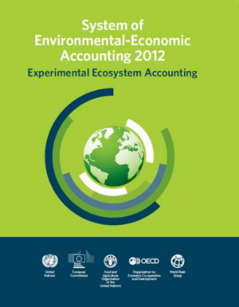
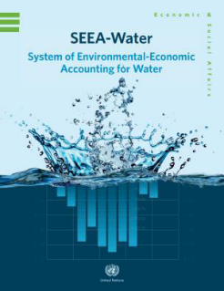
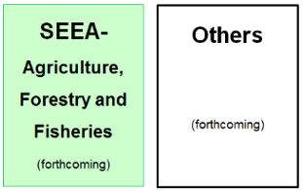
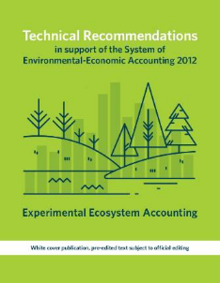
SNA and SEEA: Systems of integrated information
Source: https://seea.un.org/sites/seea.un.org/files/s2_-_seea_overview_marko.pdf

Slide 8
Prerequisites for development of SEEA and ecosystem accounts in the Russian Federation
SEEA:
ECOSYSTEM ACCOUNTING:
Normative legal basis (laws, decrees of Russian Government, acts of Rosstat and other interested agencies)
Priority areas of national policy include: Conservation and sustainable use of ecosystem services, inclusion of the value of ecosystem services in the macroeconomic development indicators (natural capital).
The concept of ecosystem services is included in the system of national standards
Proved feasibility of implementation of
CF SEEA-2012 in conditions of Russian statistics
Methodology was implemented in various projects (EIA, economic assessment of environmental damage, land tax adjustment)
Availability of a significant amount of official data. Capacity for using expert data (with further approval as official data)
Available data for the production of indicators, especially in physical terms (provisioning ecosystem services). Capacity for using expert data (value transfer, etc.)
Accumulated various experience of using SEEA in the field of territorial administration – at the national level, at the level of the subject of the Russian Federation, at the local level
Increasing implementation to solve the problems of sustainable use of natural resources and environmental protection

Slide 9
Opportunities to use SEEA and ecosystem accounting to reduce risks of strategic management errors
Environmentally sustainable development of the natural resource business, increasing employment, tax revenues
Indicators of volumes and values of stocks of natural resources, and ecosystem accounting
Decision making information system for territory development
Increasing capability to attract investments in the natural resource sector (in accordance with sustainable development principles)
Indicators of volumes and values of use of natural resources, and ecosystem accounting
More effective choice of methods of environmental management and environmental protection
Indicators of risks of depletion and degradation of natural resources, and ecosystem accounting
Development of measures to prevent depletion of natural resources and ecosystem services of a territory (decrease of stocks and degradation)

Slide 10
Opportunities to use SEEA and Ecosystem Accounting in business management
1. Standards of environmental and social responsibility of the International Finance Corporation
1.1 Use of SEEA and ecosystem accounting in environmental impact assessment
Standard 6 – Biodiversity Conservation and Sustainable Management of Living Natural Resources
At the planning stage of the investment project it’s required to assess the direct and indirect impacts on biodiversity and ecosystem services.
It’s necessary to take into account differences in values of biodiversity and ecosystem services for affected communities and other stakeholders.
1.2 Expansion of cost-benefit analysis
2. Determination of threshold values in consumption of natural assets and in environmental impacts

Slide 11
Main challenges in SEEA implementation
1. Challenge of obtaining necessary data including: (a) receiving official data - statistical and administrative, (b) analyzing available expert data and determining the possibility for its use in compiling SEEA accounts, (c) institutionalizing expert data for use in SEEA
2. The need for the use of cost-benefit analysis harmonized with SEEA is not legislated
3. Lack of interest of industry departments in SEEA development and using of its results
4. Challenge of integrating SEEA data into SNA tables (e.g., disaggregating values of natural resources by economy sectors)

Slide 12
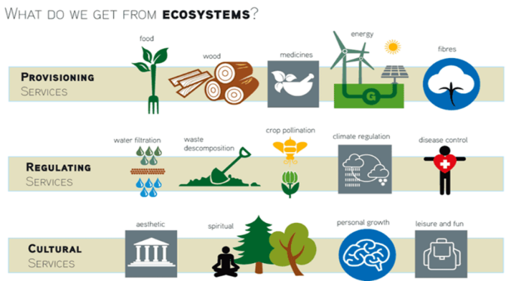
Main challenges in implementation of ecosystem accounting
SEEA estimates only part of the ecosystem services provided by a territory and consumed by beneficiaries: (1) provisioning (natural assets), (2) cultural (recreation). Important regulating functions of ecosystems are not assessed.
Source: www.ehu.eus
1. Challenge of the transition from the Labor Theory of Value to the Marginal Theory of Value, significant underestimation of natural wealth. This is especially true for post-Soviet experts, who mainly consider money as a measure of labor, but not a measure of wealth.
2. Challenge of double counting in implementation of SEEA and ecosystem accounting.

Slide 13
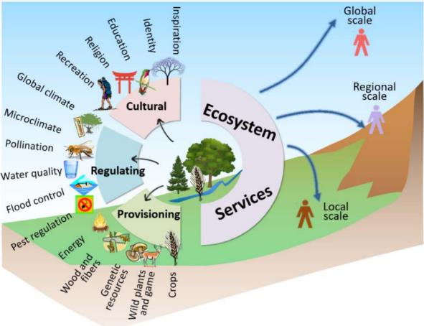
Main challenges in implementation of ecosystem accounting
Ecosystem services are always territory-specific. Their consumption, as well as restoration (e.g., forest planting) is always associated with stakeholders (beneficiaries, donors in the restoration of environmental components)
Source: Locatelli B., Vallet A., Fedele G., Rapidel B., 2017. Analyzing ecosystem services to manage territories. In: Living territories to transform the world, Cirad-Quae, pp.106-110
3. Lack of attention to the scale of ecosystem services assessment in management, and to the "targeting" of measures and potential conflicts (e.g., loss of income of the local population in favor of maintaining global ecosystem services). Cases of assessing ecosystem services in general, without identifying specific beneficiaries
4. Lack of understanding of the role of unified principles of ecosystem accounting in Environmental Impact Assessment (EIA) and Strategic Environmental Assessment (SEA), using cost-benefit analysis.

Slide 14






Thank you for your attention!
Russian Federal State Statistics Service (Rosstat)
E-mail: stat@gks.ru
www.gks.ru
39, Miasnitskaya St., bldg.1, Moscow, Russia, 107450
Phone: 8 (495) 607-46-77
Research and Consulting Syndicate
Cadaster Institute
E-mail: info@nipik.ru
www.npo-kad.ru
1 Belinskogo Street, Yaroslavl, Russia, 150043
Phone: 8 (4852) 75-76-46
http://ntc-rik.ru/en/knowledge-center/library

